Slide 1

ELECTRIC GO-KART PROJECT
Subject Code - MER-389
Department - Mechanical (ME-1)
Batch – 2019/2023
By-
(19BME1095) Chetan Salunke
(19BME1087) Saurabh Sharma
(19BME1089) Divesh Thakur
(19BME1090)Harshit Sharma

Slide 2

INDEX
Introduction
Application of Electric go-kart
Frame Design
Steering System
Braking System
About battery
Speed Controller
Motor
Wheels
Manufacturing rules
Complete 3D views
Safety
Approximate cost

Slide 3
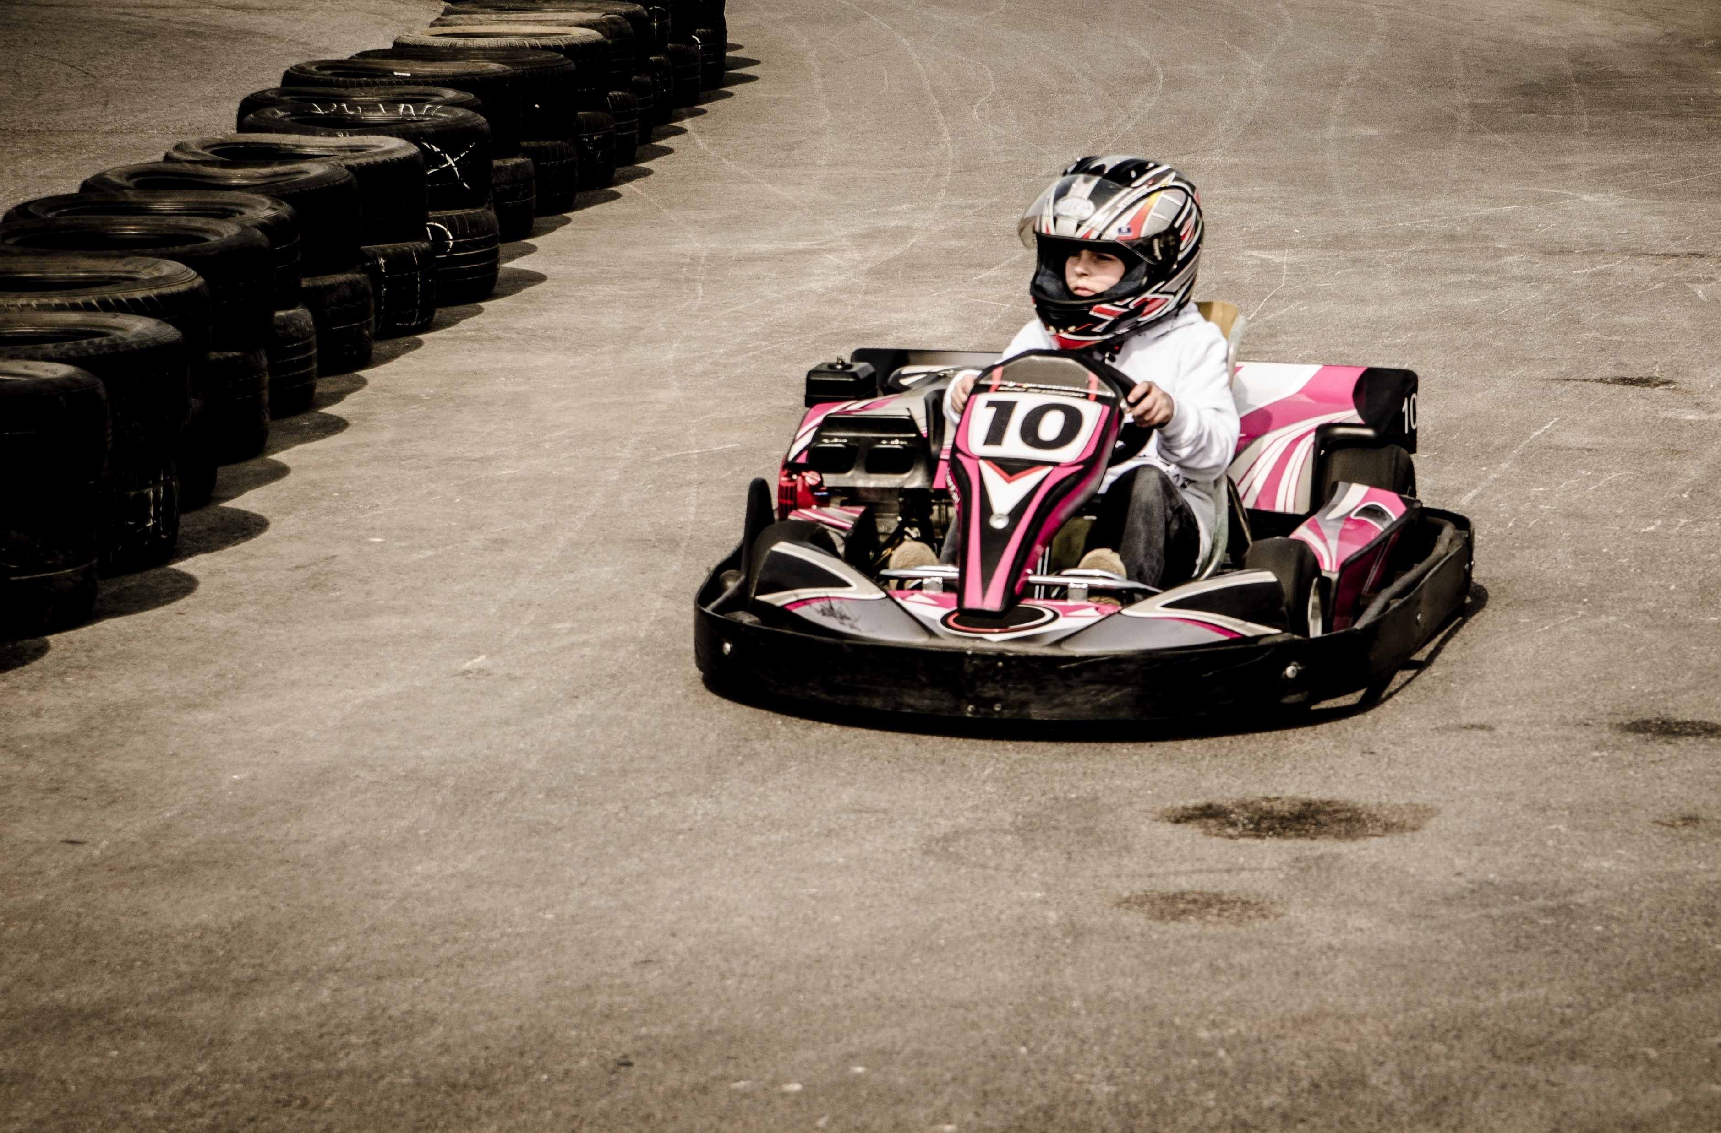
Introduction
By – Harshit Sharma
The Go-Kart is a vehicle which is simple, lightweight and compact and easy to operate. The go-kart is specially designed for racing and has very low ground clearance when compared to other vehicles. The common parts of go-kart are engine, wheels, steering, tyres, axle and chassis. No suspension can be mounted to go-kart due to its low ground clearance.
The JK Tyre National Karting Championship offered a real boost to the efforts the company undertook in taking the sport to the masses. The company introduced the discipline in 1997 and patronized tracks in seven cities across India and thereafter developed a karting series in 2000

Slide 4
Methodology
Frame design
Steering system design
Brake and wheels
Drive train design
Bodywork design
Assembly of sub design
Analysis of Design
Body and composites
Study of Engine
Fabrication of Chassis
Fabrication of Parts to Chassis
Driving and Testing
Calculation of actual parameters of Kart.
Comparison of actual and design parameters.

Slide 5
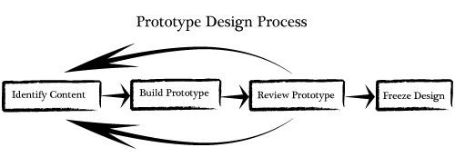
Prototype
The SMITSONICS started with the process of brainstorming; literature review and continued with designing; design analysis; fabrication; assembly and documentation according to the standard specification of Go-kart.
We approached our design by considering all possible alternatives for a system and modeling them in CATIA V5. The model was then modified and retested for the final design. The design process of the vehicle is iterative and is based on various engineering and reverse engineering processes depending upon the availability, cost and other such factors. The design objectives, set out to be achieved were three simple goals applied to every component of the vehicle: durable, light-weight and high performance, to optimize the design by avoiding over designing, which would also help in reducing the cost, with this we had a view of our kart. This started our goal and we set up some parameters for our work,

Slide 6
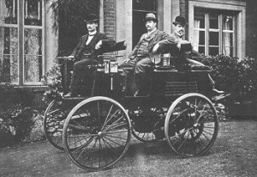
Application of Electric Car
By - Harshit Sharma
The first known electric car was built by chemist Robert Davidson in Aberdeen, Scotland, in 1837—48 years earlier than the first internal combustion car. Thomas Parker, an English inventor, built the first practical electric car in London in 1884 and started production soon thereafter.
Benefits of Electrical Transportation
1) Reduced Pollution
2) Cost Savings
3) Economic Growth

Slide 7
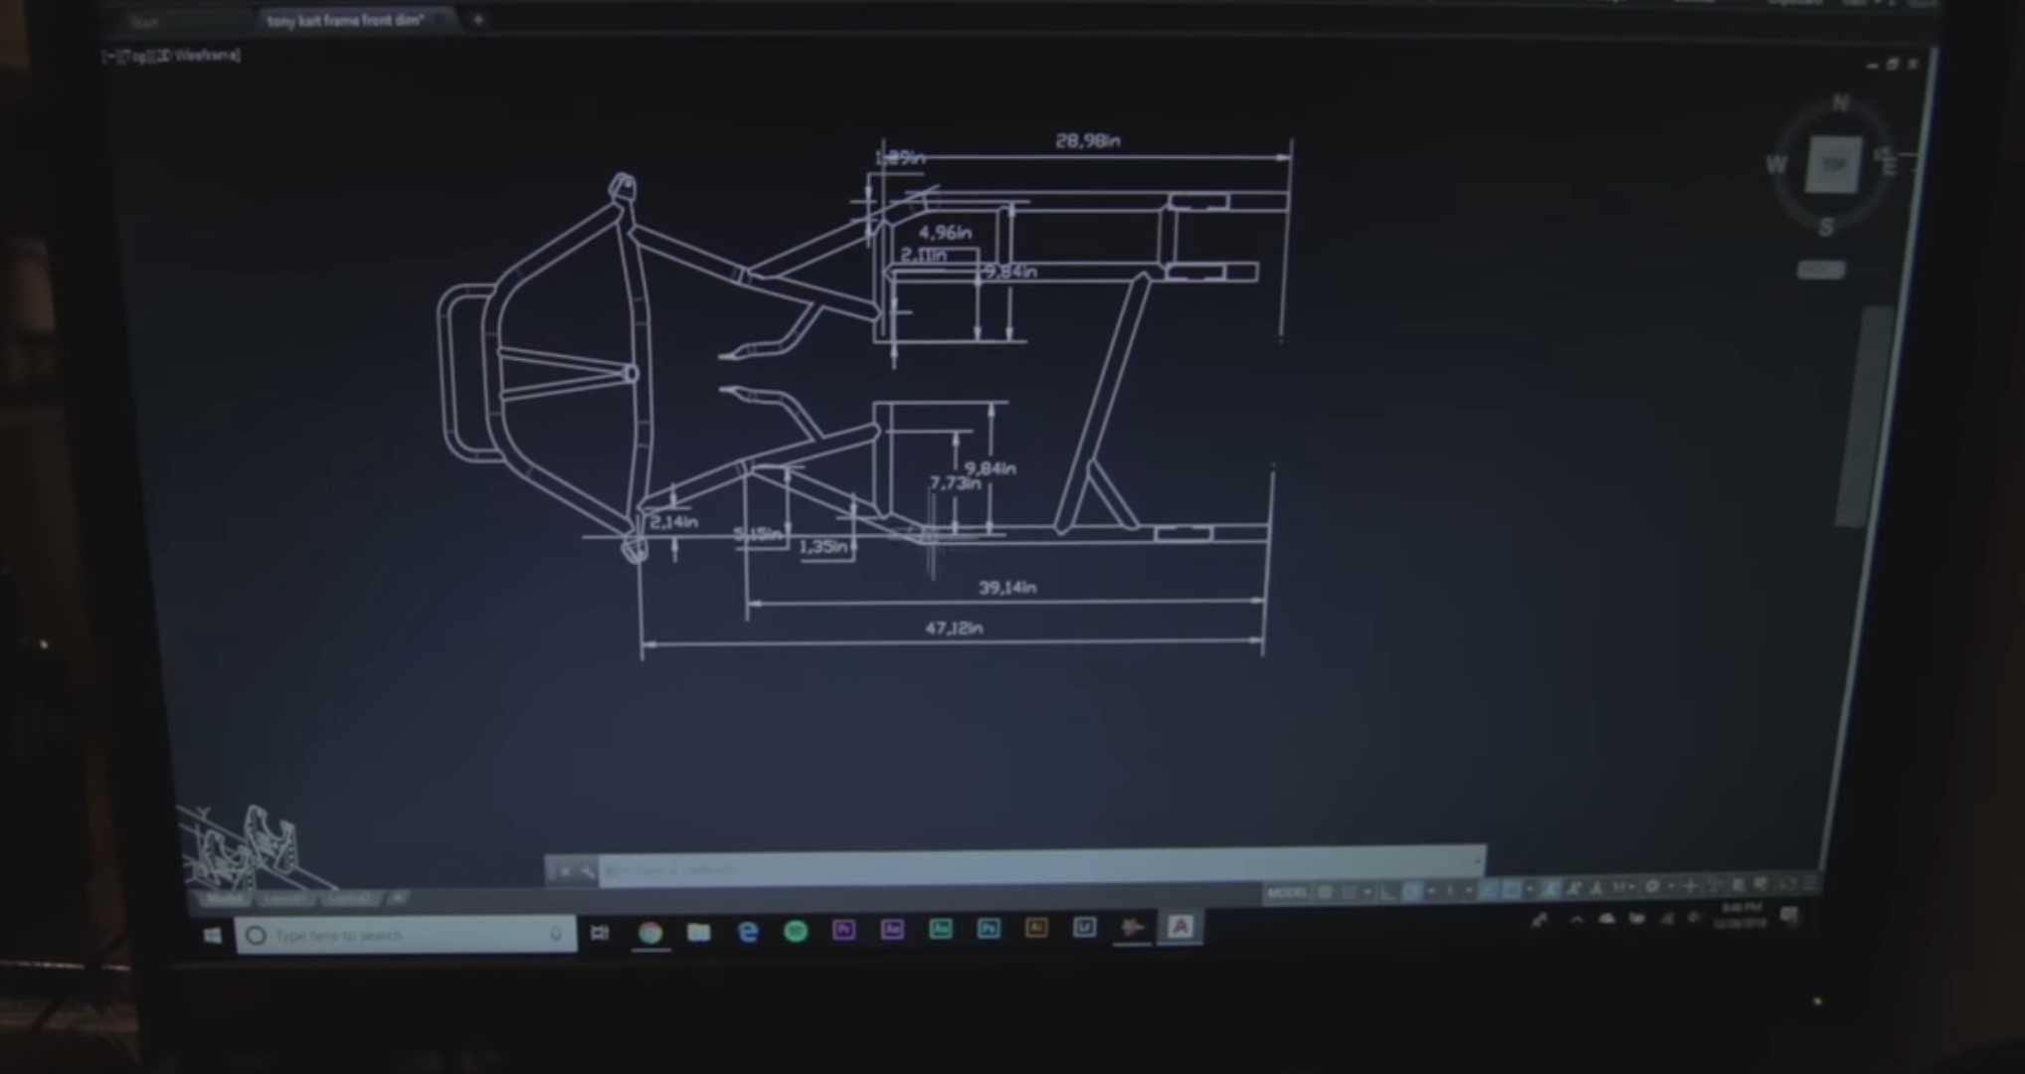
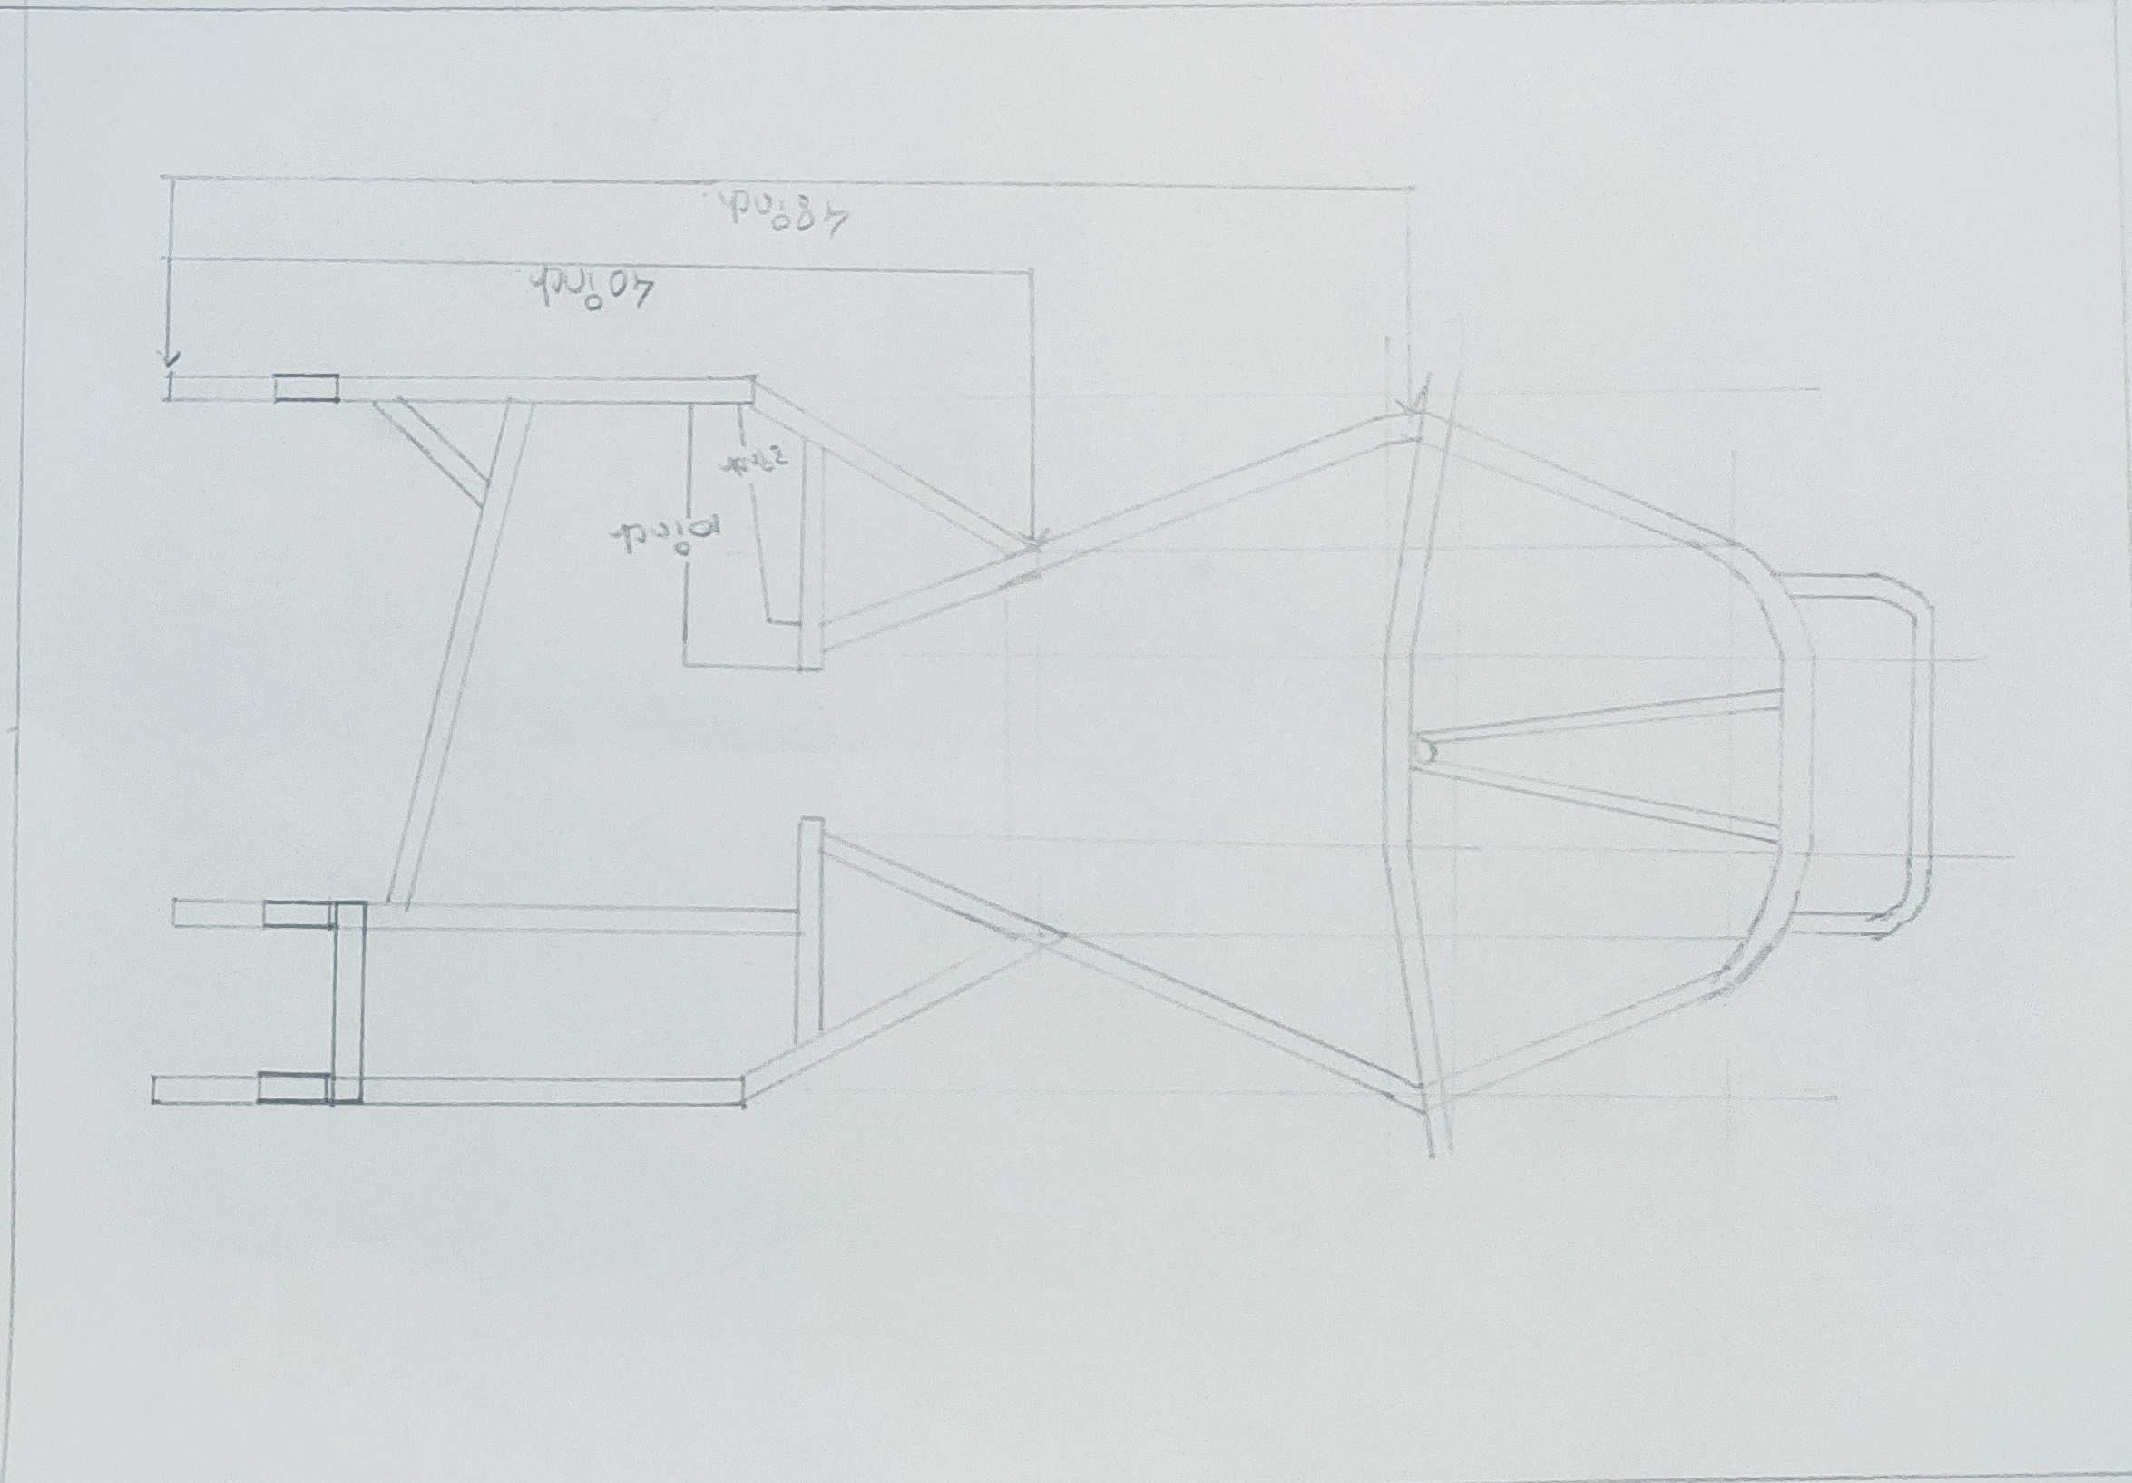
Frame Design
By - Chetan Salunke
The chassis of go-kart is a skeleton frame made up of hollow pipes and other materials of different cross sections. The chassis of go-kart must be stable with high torsional rigidity, as well as it should have relatively high degree of flexibility as there is no suspension
The tube/rectangular pipe used in the fabrication of the chassis or the other frames/supports may be seam or seamless. Minimum cross section must be 1 inch (25.4mm), for pipe it will be OD and for rectangular section or square section it will be its minimum height. Material certification is essentially0 required to be produced during the technical inspection

Slide 8
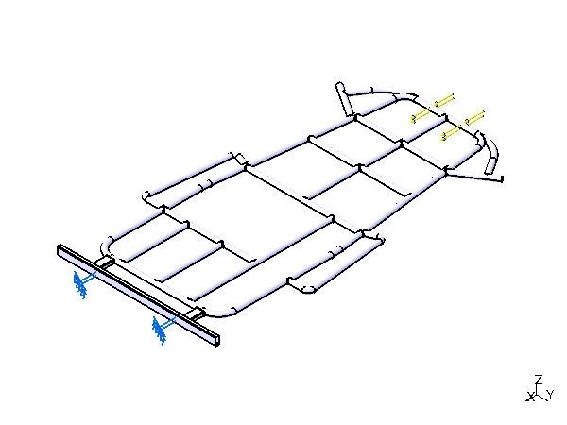
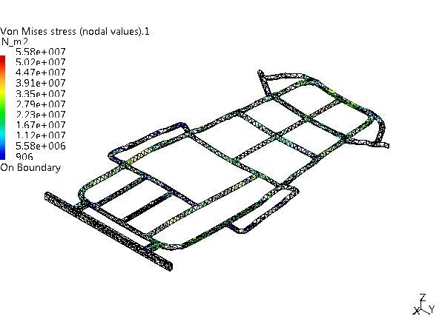
Testing and Calculations
Keeping the frame as light as possible was a top priority. When power is limited, vehicle weight is a large factor in vehicle performance. The frame is one of the largest and heaviest components of the car, and which is why special attention was placed on the vehicle’s frame weight. The strategy utilized to minimize weight consisted of determining defined goals for the chassis and employing the correct material in the best places to accomplish those goals. Once baseline safety design requirements were met, FEA aided the material decision making process. FEA specifically helped to determine whether a member was under high or low stresses, in the scenarios discussed previously, making the chassis design process efficient and effective.

Slide 9
Impacts
Table 5.4 Maximum translational displacement and Factor of Safety Calculation
Type of Test | Acc. | Load (N) | Impulse Time | Max. Translational Disp. (mm) | Max. Von Mises Stress (N/mm2) | FOS
Static Test | - | 1000 | - | 0.146 | 12.2 | 20.49
Front Impact | 4g | 8000 | 0.42 s | 0.289 | 55.8 | 4.48
Rear Impact | 4g | 8000 | 0.42 s | 0.285 | 56.7 | 4.40
Left Side Impact | 2g | 4000 | 0.83 s | 0.709 | 99.4 | 2.51
Right Impact Test | 2g | 4000 | 0.83 s | 0.586 | 86.8 | 2.88

Slide 10
Chassis
By - Chetan Salunke
The chassis of a go-kart or also known as the go-kart frame is like a foundation that attached to the axles and holds the engine of the go-kart. It is crucial to have a good design of chassis that will it gives the go-kart better traction for the driver to especially diving in corners at high speeds. Hence, according to Walker (2005), the absence of conventional suspension in go-kart compare to a normal vehicle requires the chassis itself to be flexible as a replacement of the suspensions. Yet, the go-kart chassis has to be rigid enough to withstand the strains it might experience such as weight of the drivers. In addition, a good traction from a proper design will also have less vibration which resulting a longer chassis life span.
There are four types of chassis which are caged, open, offset and straight chassis. A caged chassis have a roll cage that surrounds and protect the driver in an event of a roll-over

Slide 11
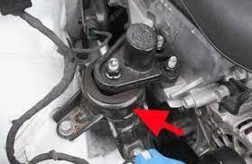
Engine Mounting
Engine mounting is of flexible type. Any go kart engine can be mounted on the go kart, irrespective of its size and power. Most of the time, the chain length may vary due to external factors such as temperature changes, dragging of the chain or a loose sprocket. Usage of this mechanism allows us to tighten or loosen the chain easily. Since the tray is directly attached to the chassis, the engine load is evenly distributed. This flexible mounting consists of a metal tray directly attached to the chassis on which the engine is mounted. The position of the tray can be changed by adjusting the nut bolt mechanism present in it. During most of the test runs, the vehicle had the problem of unwanted chain slagging. So to rectify this, this mechanism was introduced.

Slide 12
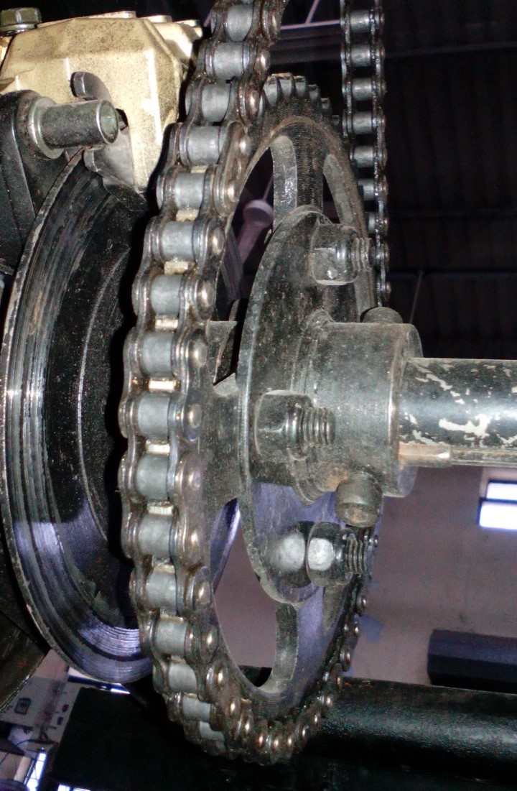
Chain and Sprocket
In the case of go-kart chains, it is possible to modify the overall gear ratio of the chain drive by varying the diameter (and therefore, the tooth count) of the sprockets on each side of the chain. This is the basis of derailleur gears. A multi-speed g-kart, by providing two or three different-sized driving sprockets and up to 11 (as of 2014) different-sized driven sprockets, allows up to 33 different gear ratios. The resulting lower gear ratios make the bike easier to pedal up hills while the higher gear ratios make the bike more powerful to pedal on flats and downhill. In a similar way, manually changing the sprockets on a motorcycle can change the characteristics of acceleration and top speed by modifying the final drive gear ratio

Slide 13
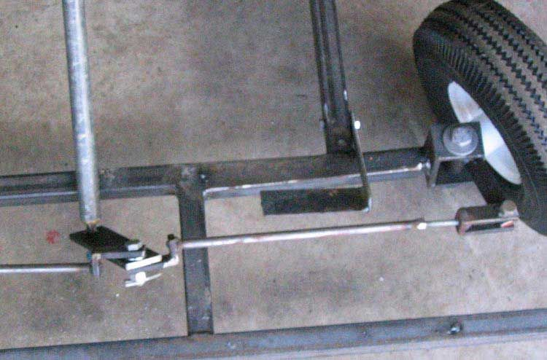
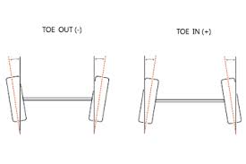
Steering System
By - Divesh Thakur
The steering system must be able to control (simultaneously) at least two (2) wheels. The steering system must have positive steering stops that prevent the steering linkages from locking up either in RH or LH turning
Toe angle
Toe angle is the angle that a wheels makes with a line drawn parallel to the length of the car when viewed from above
Negative and positive toe angle
1)Toe in
2)Toe out
3)Neutral
We used neutral steering system in go-kart

Slide 14
Steering System
The steering system is designed to withstand the stress of safely the vehicle through any type of possible condition at the time of driving. The purpose of the steering system is to provide directional control of the vehicle with minimum input. The main goal for steering radius of 4m or less and have 100% Ackerman steering.
Steering system must be controlled by a steering wheel which a continuous rim not incorporating any reflex angles in its basic shape. The upper and lower 1/3 of the circumference may be straight or of a different radius to the rest of the wheel. The rim must be manufactured with a metallic structure made of steel or Aluminium. Any device mounted on the steering wheel must not protrude by more than 20 mm from the plane forward of the steering wheel and must not have sharp edges. Flexible steering controls by cable or chain are forbidden. All parts of the steering must have a method of attachment offering maximum safety (split pins, nuts or burred bolts). The steering column must have a minimum diameter of 18 mm and a minimum wall thickness of 1.8 mm. It must be mounted with a safety clip system for the lower bearing restraint nut. The steering column must be made of steel.

Slide 15
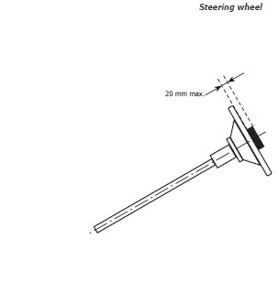
Consideration
Simplicity and safety were the main design specifications for the vehicle’s steering system. While designing the steering system the constraints that we possessed were centar alignment of steering system track width, human effort at the steering wheel and the desired response of the steering system. A pivot pin steering arrangement was chosen due to its light weight, simple design and low cost. Very less play due to limited number of joints.
The steering knuckles system is where the axles themselves, which are mounted on a knuckles, out and away from the go kart, and they actually rotate around these pivots, and cause the wheels to turn.

Slide 16
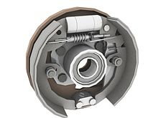
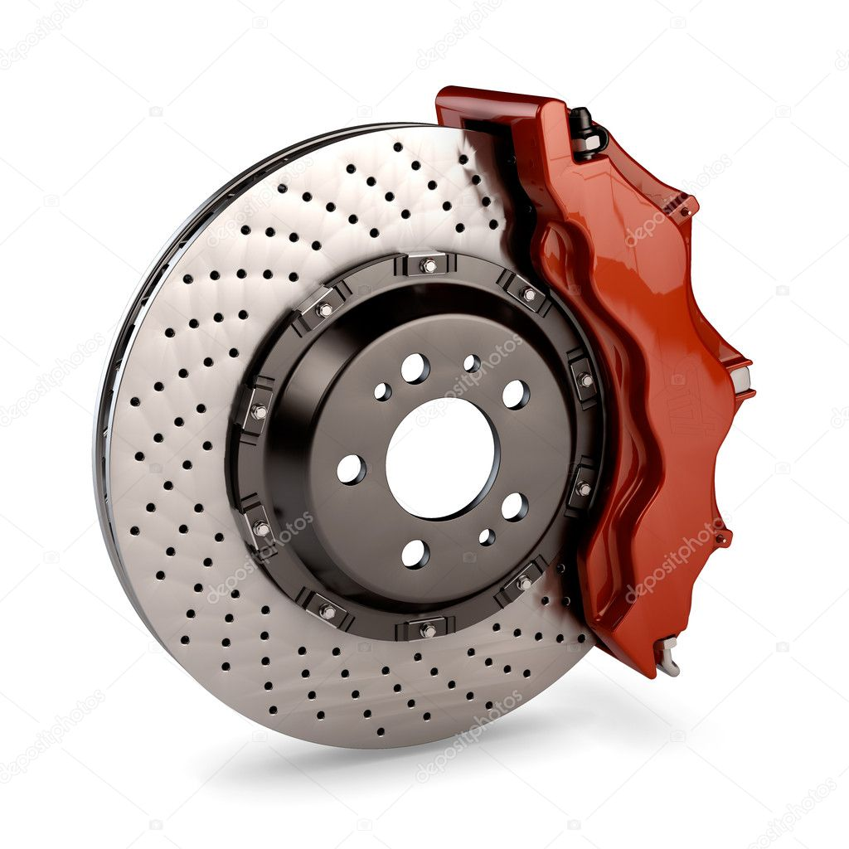
Braking System
By - Saurabh Sharma
Brakes are essentially a mechanism to change energy forms. When you are travelling at speeds your vehicle has kinetic energy. When you apply the brakes the pads or shoes that press against the brake drum or rotor convert that energy into thermal energy via friction
Types of brakes
1)Drum
2)Disc brake
We used disc brake in go-kart

Slide 17
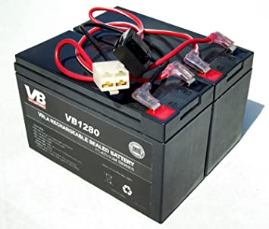
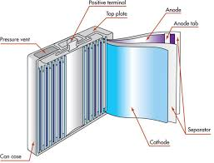
About Battery
By - Divesh Thakur
Batteries are a collection of one or more cells whose chemical reactions create a flow of electrons in a circuit. All batteries are made up of three basic component an anode (the ‘–’side ) a cathode (the ‘+’ side) and some kind of electrolyte (a substance that chemically reacts with the anode and cathodes)
We used 12v+12v=24v battery in go-kart
Lithium-ion battery
Batteries used in EV are generally lithium-ion based batteries because they offers a very high volumetric energy density and the energy to weight ratio is also high.
They can be recharged again and again for over a large number of times without any effect on the healthy of battery

Slide 18
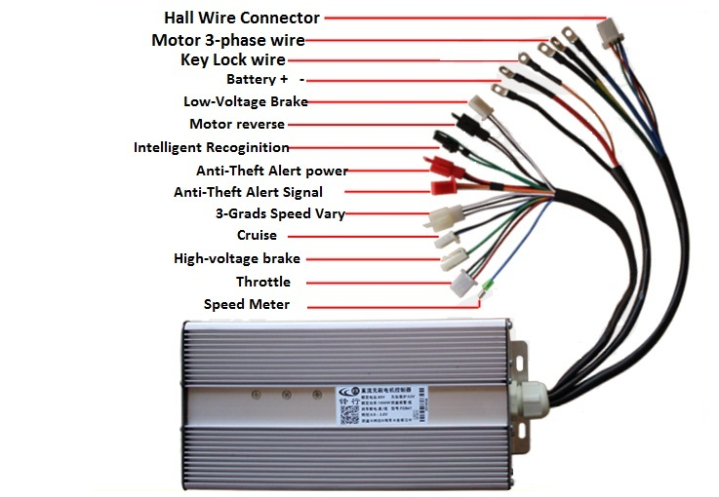
Speed Controller
By - Chetan Salunke
The controller or electronic speed controller (ESC) is an electronic circuit that controls the speed of the motor in an electric scooter. It receives input from the throttle and precisely controls the flow of current from the battery to the motor. For most scooters, the controller also provides regenerative braking capabilities.
Types of speed controller
1) 250v (scooter)
2) 350v (bike) or (go-kart)
3) 650v (electric sport bike)

Slide 19
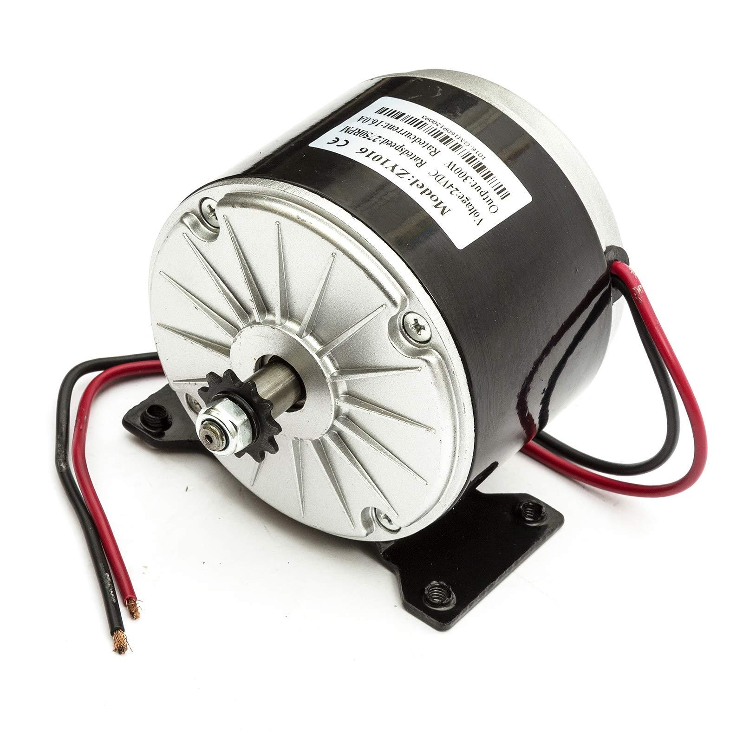
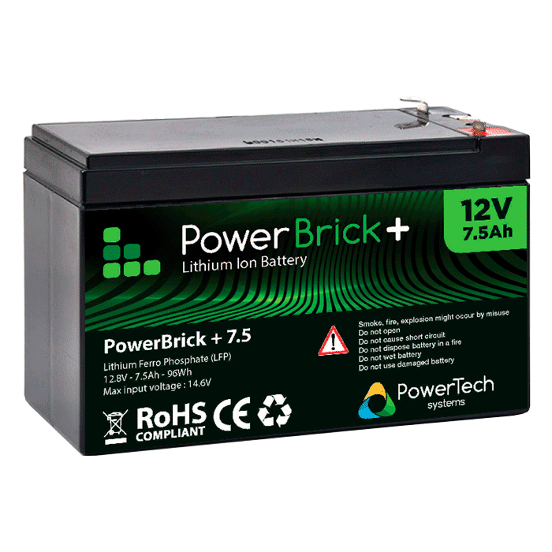
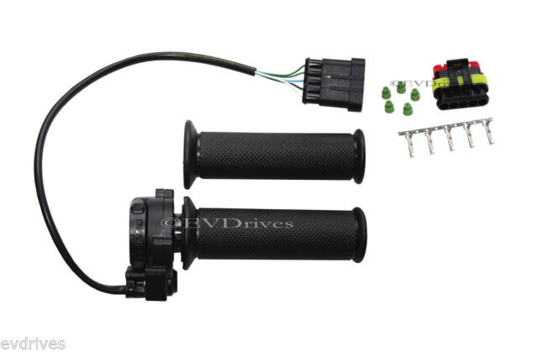
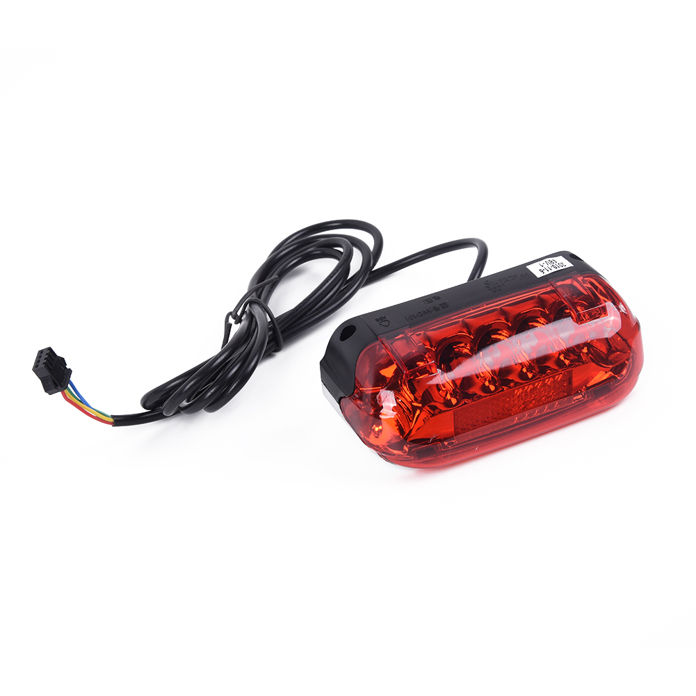
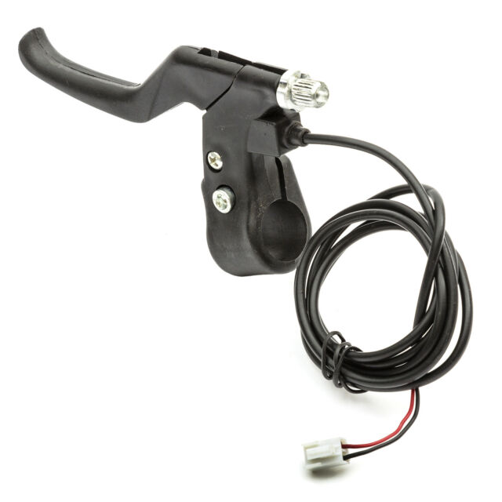
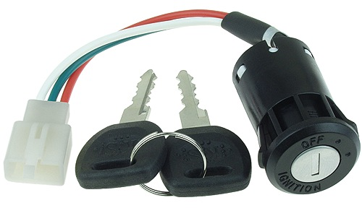
Important keys in speed controller
By - Chetan Salunke
Battery
Motor
Throttle
Power lock (ignition)
Brake light
Indicator lights
Brake

Slide 20
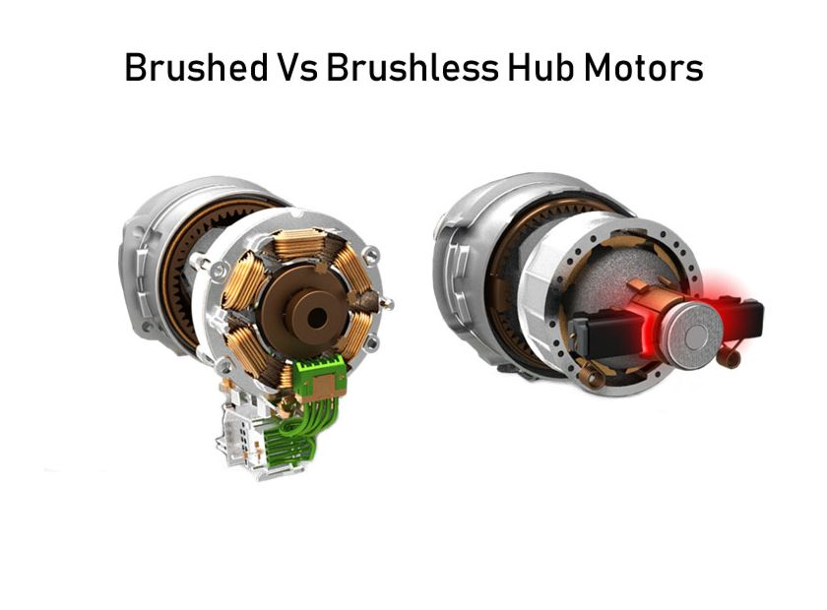
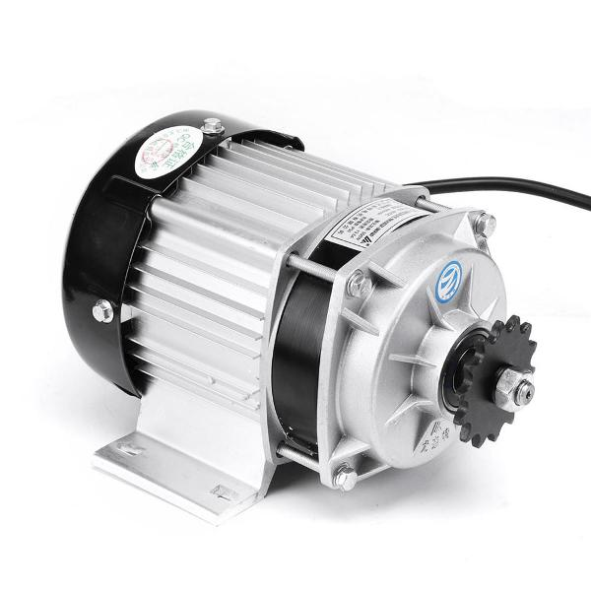
Electric motor
By - Saurabh Sharma
Due to low inertia, BLDC motors have faster acceleration. BLDC motors have less weight. They can run at high speed than a conventional DC motor They have many advantages like low cost, simplicity, reliability, good performance, long life.
We used Electric go kart motor BLDC motor, rated current: 42A A Brushless DC motors require less maintenance The considerable power output of 2000W ensures its high working efficiency. Voltage: DC 48 V.

Slide 21
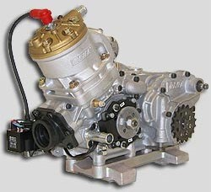
Engines
Typical go-kart will have two-stroke and four-stroke engines to choose from. By referring to Vortex’s engine specifications, a two-stroke engine usually produces power at range of 8hp single-cylinder unit to 90hp with a twin cylinder unit (Vortex, 2010). Whereas, four-strokes engine from manufacturer such as Axis which can produces at maximum power up to 45hp Engine of a kart is also as important as the chassis as it drives the go-kart around the track.

Slide 22
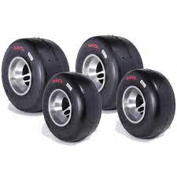
Wheels
By - Divesh Thakur
A wheel is a circular component that is intended to rotate on an axial bearing. The wheel is one of the main component of the wheel and axle which is one of the six simple machines, wheels, in conjunction with axles allow heavy objects to be mover easily facilitating movement or transportation while supporting a load
Tire properties
1)Non-skidding
2)Uniform wear
3)Load carrying
4)Tyre noise
Dimension of tyre used in go-kart
Front tyre is 10*4.5-5
Rear tyre is 11*7.1-5

Slide 23
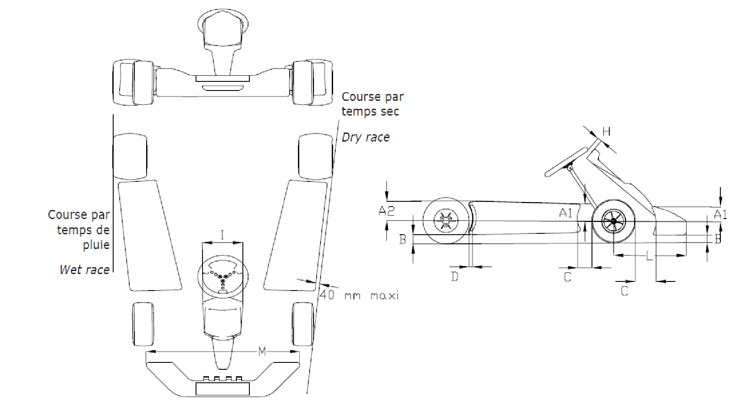
Fibre Parts
The bodywork is made up of all parts of the kart that are in contact with air, other than mechanical parts, the fuel tank and number plates. The bodywork must be impeccably finished, in no way of a make-shift nature and without any sharp angles. The minimum radius of any angles or corners is 5 mm. It must be made up of two side bodyworks, one front fairing, one front panel and one possible rear wheel protection. No element of the bodywork may be used as fuel tank. No cutting of bodywork elements is allowed. They must under no circumstances be located either above the plane through the top of the front and rear tires or beyond the plane through the external part of the front and rear wheels (with the front wheels in the straight ahead position). In the case of a “Wet race”, side bodywork may not be located outside the plane passing through the outer edge of the rear wheels

Slide 24
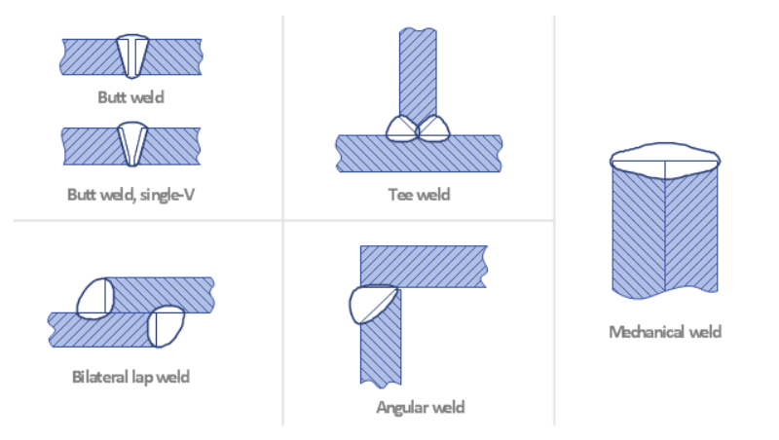
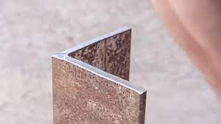
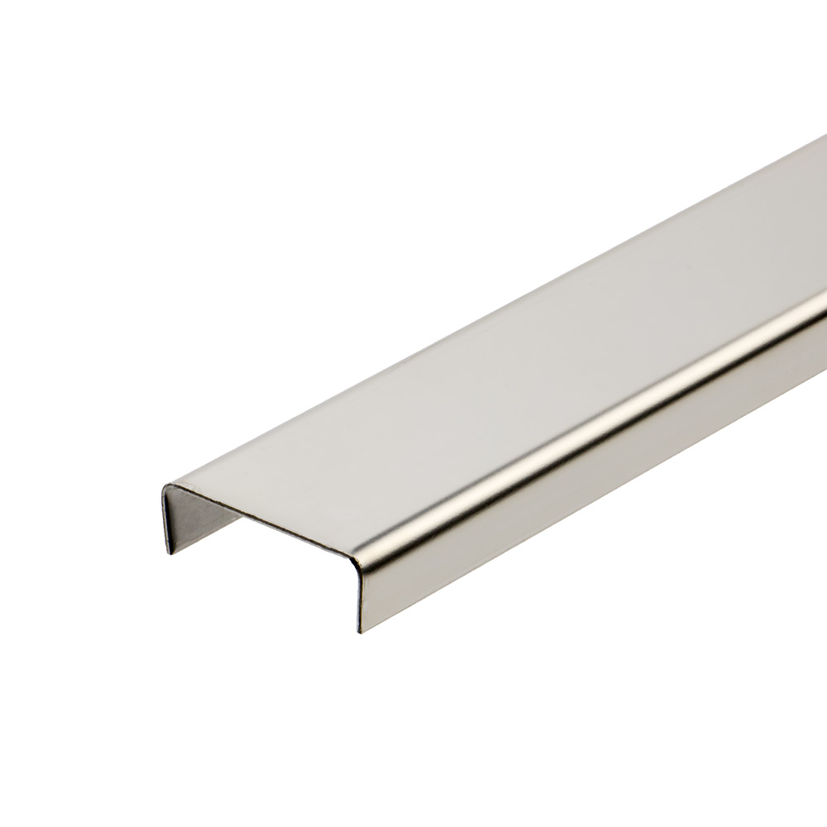
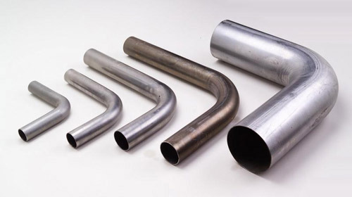
Manufacturing rules
By - Saurabh Sharma
Visibility Requirements
Path for wires and pipes
Pipe Bending
Pipe Joint
No sharp edges

Slide 25
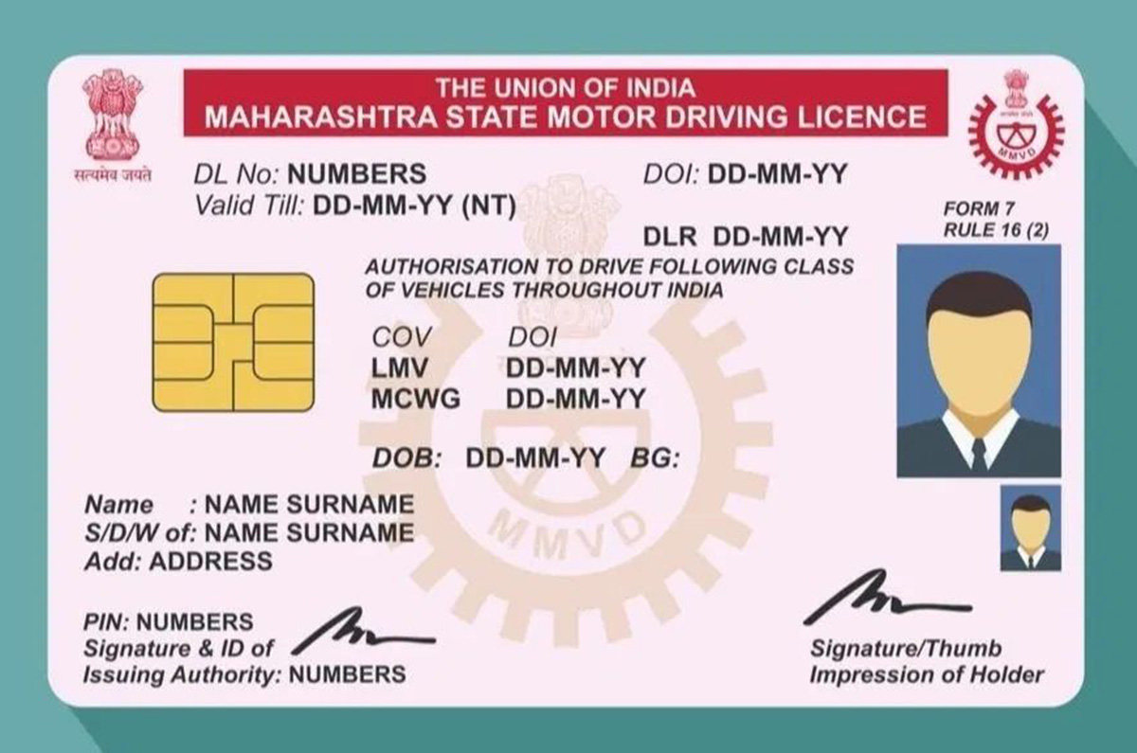
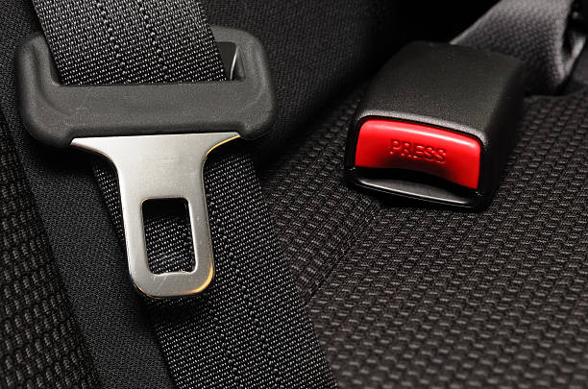
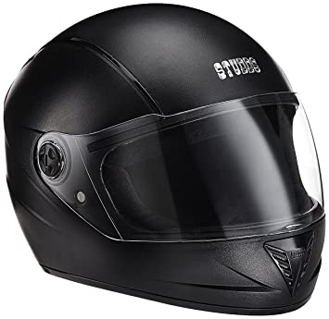
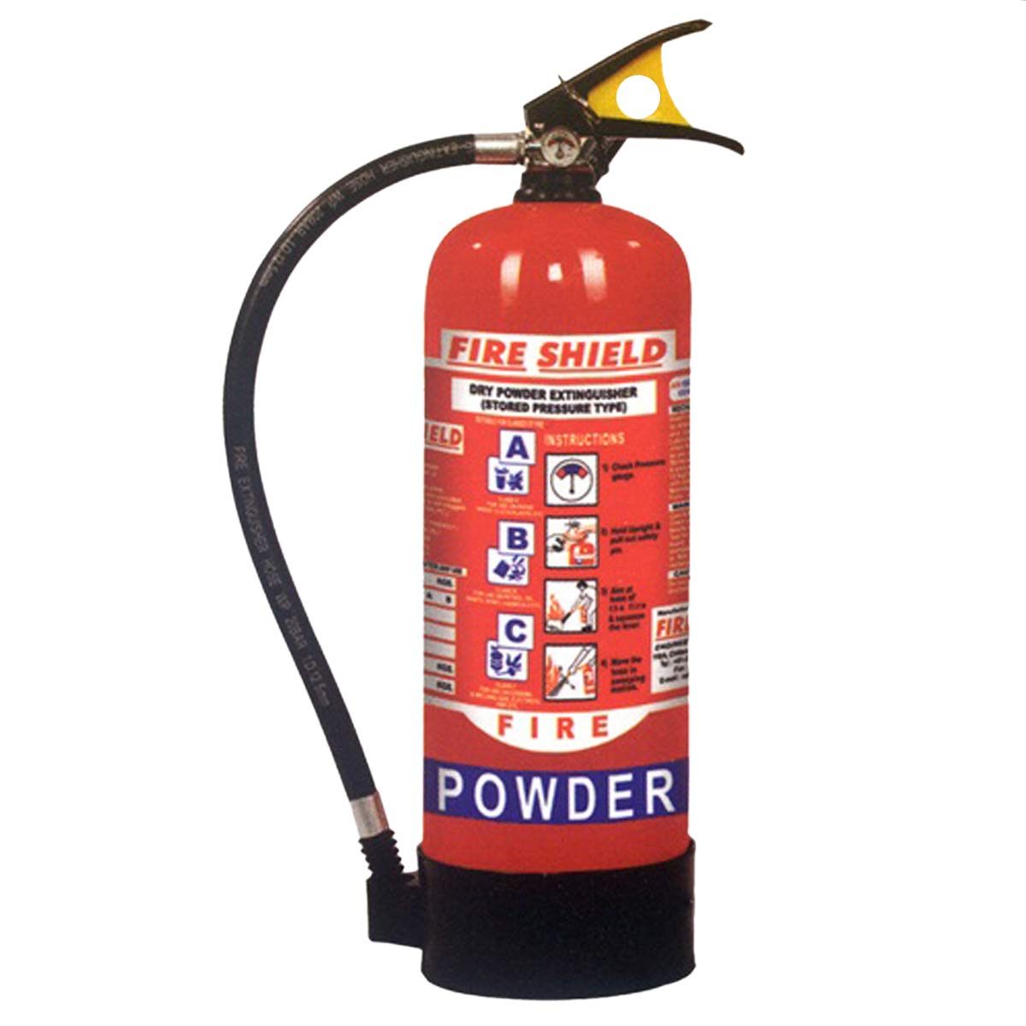
Safety
By - Harshit Sharma
1) Age-
2) Driver’s License
3) Driver’s Insurance
4) Helmet-
5) Fire Extinguisher
6) Seat Belt

Slide 26
Failure Modes
By - Chetan Salunke
Structural failure can occur in FRP materials when:
Tensile forces stretch the matrix more than the fibres, causing the material to shear at the interface between matrix and fibres.
Tensile forces near the end of the fibres exceed the tolerances of the matrix, separating the fibres from the matrix.
Tensile forces can also exceed the tolerances of the fibres causing the fibres themselves to fracture leading to material failure
FRP is used in designs that require a measure of strength or modulus of elasticity that nonreinforced plastics and other material choices are either ill suited for mechanically or economically.

Slide 27
Approximate cost
Steering System - 1000
Wheels - 3200
Safety - 2000
Electric motor - 5000
speed controller - 2500
Battery - 9000
Braking System - 2000
Wiring - 1000
Body – 3000
28700

